Slide 1
Movie Complexity and Ratings
Ingo Nader

Slide 2
Dataset(s)
In the analysis, the IMDB movie dataset was used⁽¹⁾. It describes 5-star rating and free-text tagging activity from [MovieLens](http://movielens.org), a movie recommendation service. It contains 20000263 ratings and 465564 tag applications across 27278 movies. These data were created by 138493 users between January 09, 1995 and March 31, 2015.
Of this dataset, two tabular files were used for the analysis:
movies.csv: movie IDs and movie genres (and title – not used in this analysis)
ratings.csv: movie IDs and ratings per user (and userID, timestamp – not used)
_____
⁽¹⁾ available from: http://files.grouplens.org/datasets/movielens/ml-20m.zip

Slide 3
Motivation
Personally, I find movies that are too simple not entertaining. I tend to like more complex movies better. Hence, in order to shed light on this in a more empirical way, I wanted to research the relationship between complexity and movie ratings, the hypothesis being that this relationship of more complex movies being rated more positively holds for a more general population (i.e., in this dataset).

Slide 4
Research Question(s)
I tried to answer the following research questions in my work:
Is there a relationship between (average) movie rating and movie complexity?
Does this relationship vary for different movie genres?
Movie complexity was measured directly (because it is not part of this dataset), but via a heuristic: It was assumed that more complex movies are categorized into more genres. Hence, the measure for complexity is the number of genres that the movie was associated with.

Slide 5
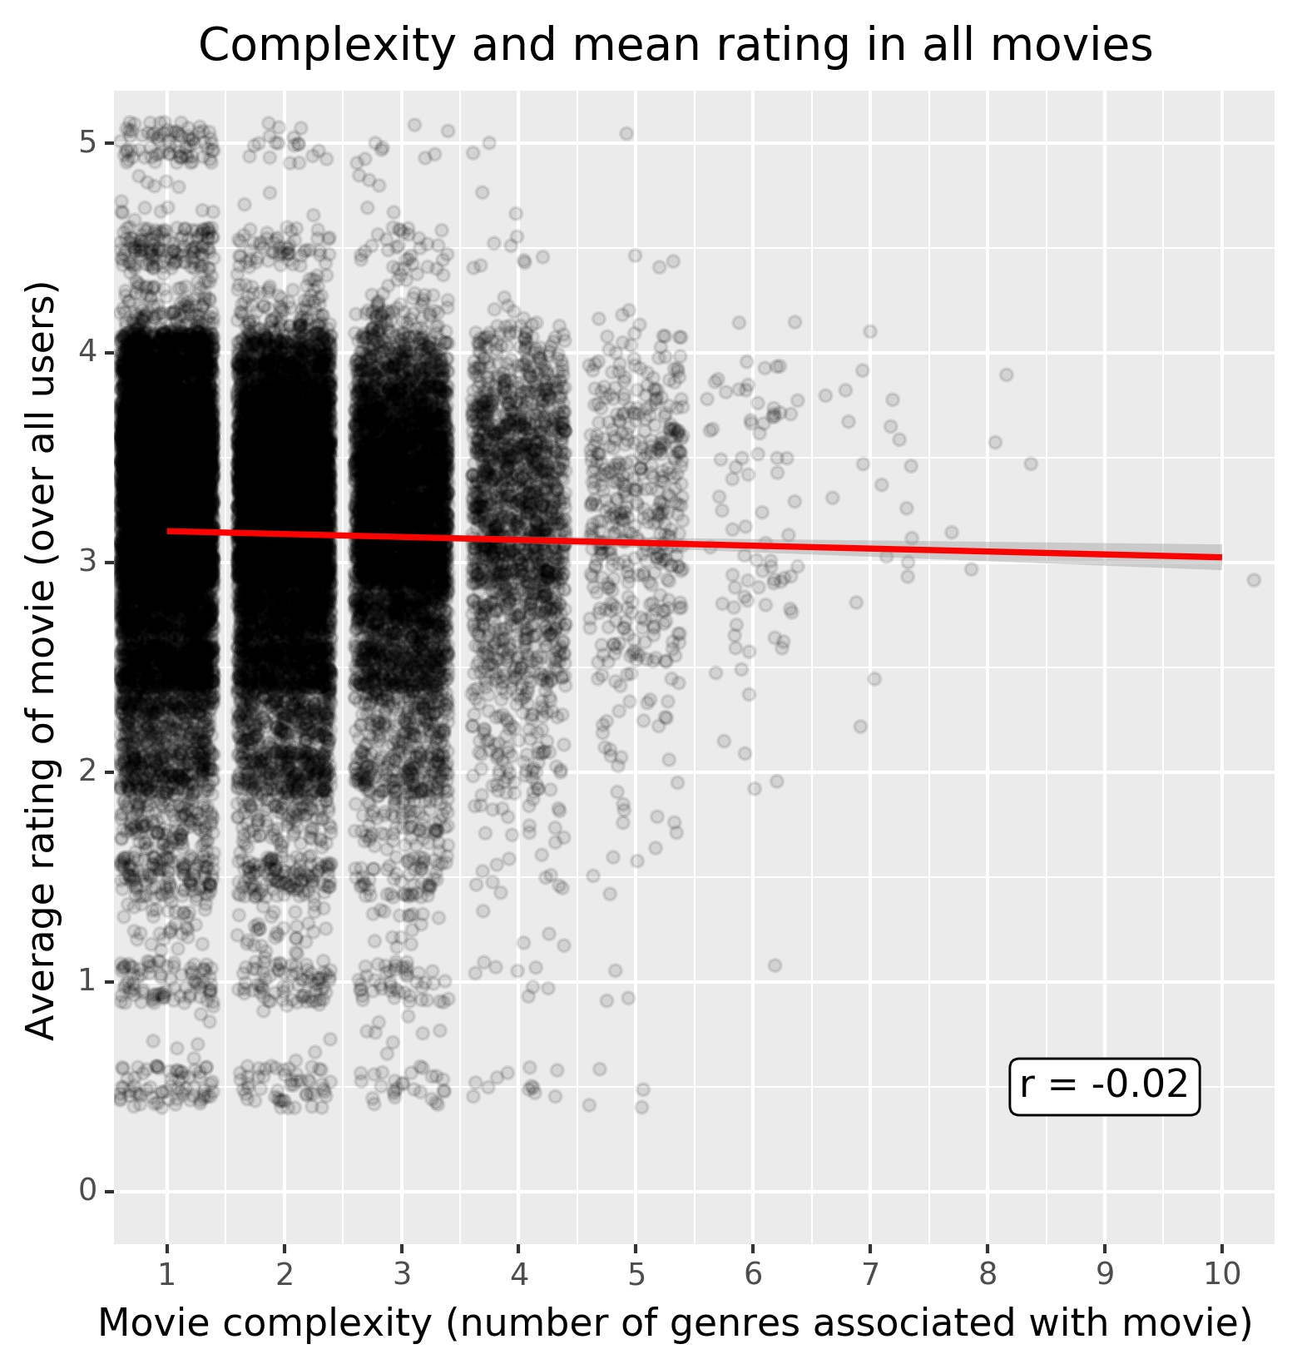
Findings
Overall, the hypothesis of a (linear) relationship between complexity and rating is not supported by data (Pearson correlation r = -0.02).
It seems that the variance of movie ratings varies with movie complexity:
Less complex moves have higher spread of ratings, ranging from 0.5 to 5.0.
More complex movies have lower spread of average ratings.
Figure: Movie ratings averaged over all users for each movie, complexity as measured by the number of genres indicated for each movie. Data is jittered to better show spread (random jitter added for ratings: ±0.1; for complexity: ±0.4). Red line depicts a linear regression model fitted to the data in the plot.

Slide 6
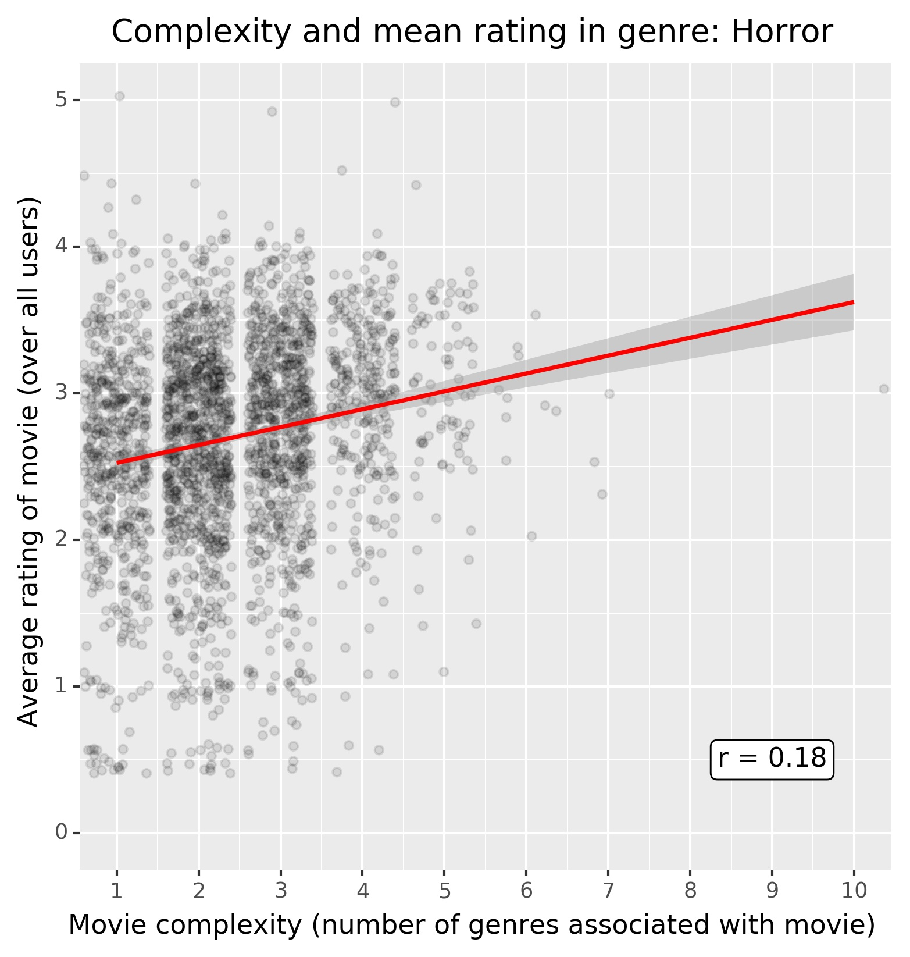
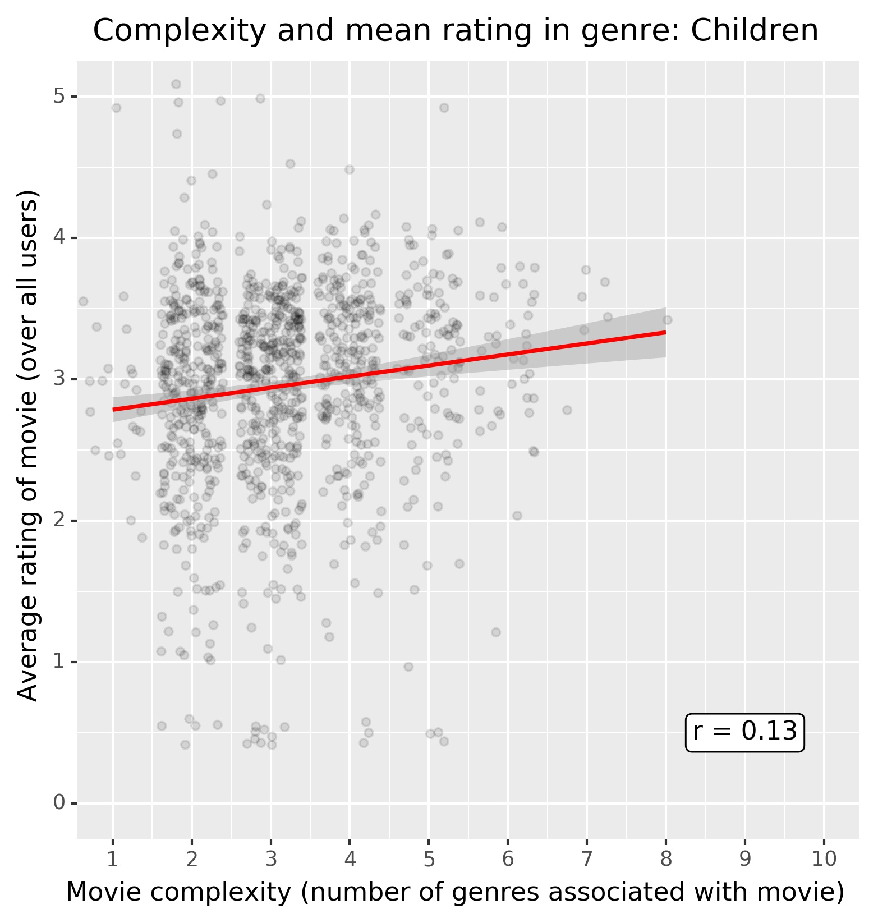
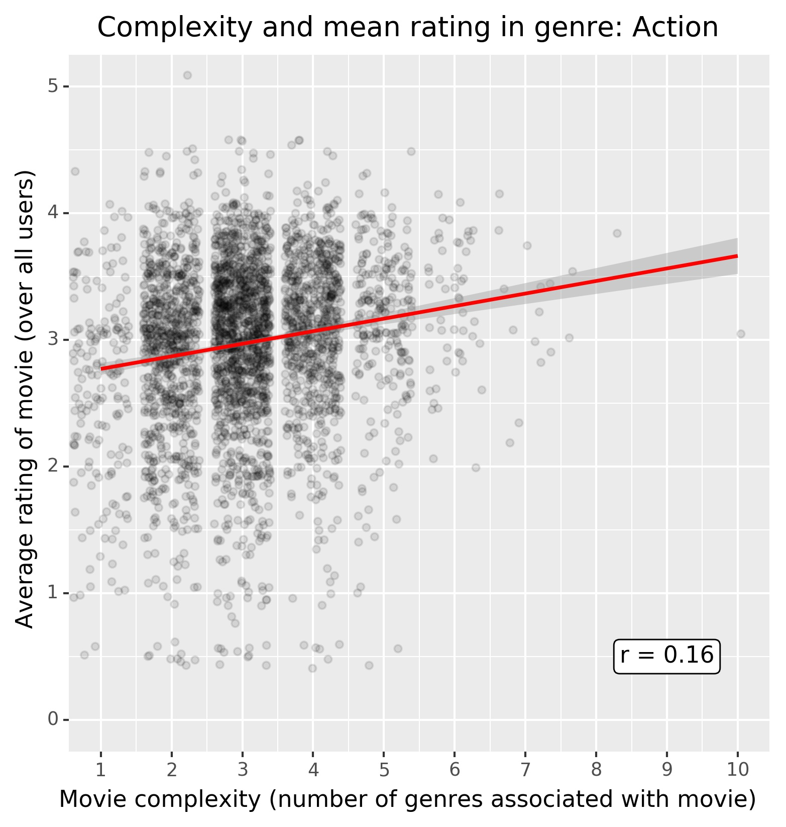
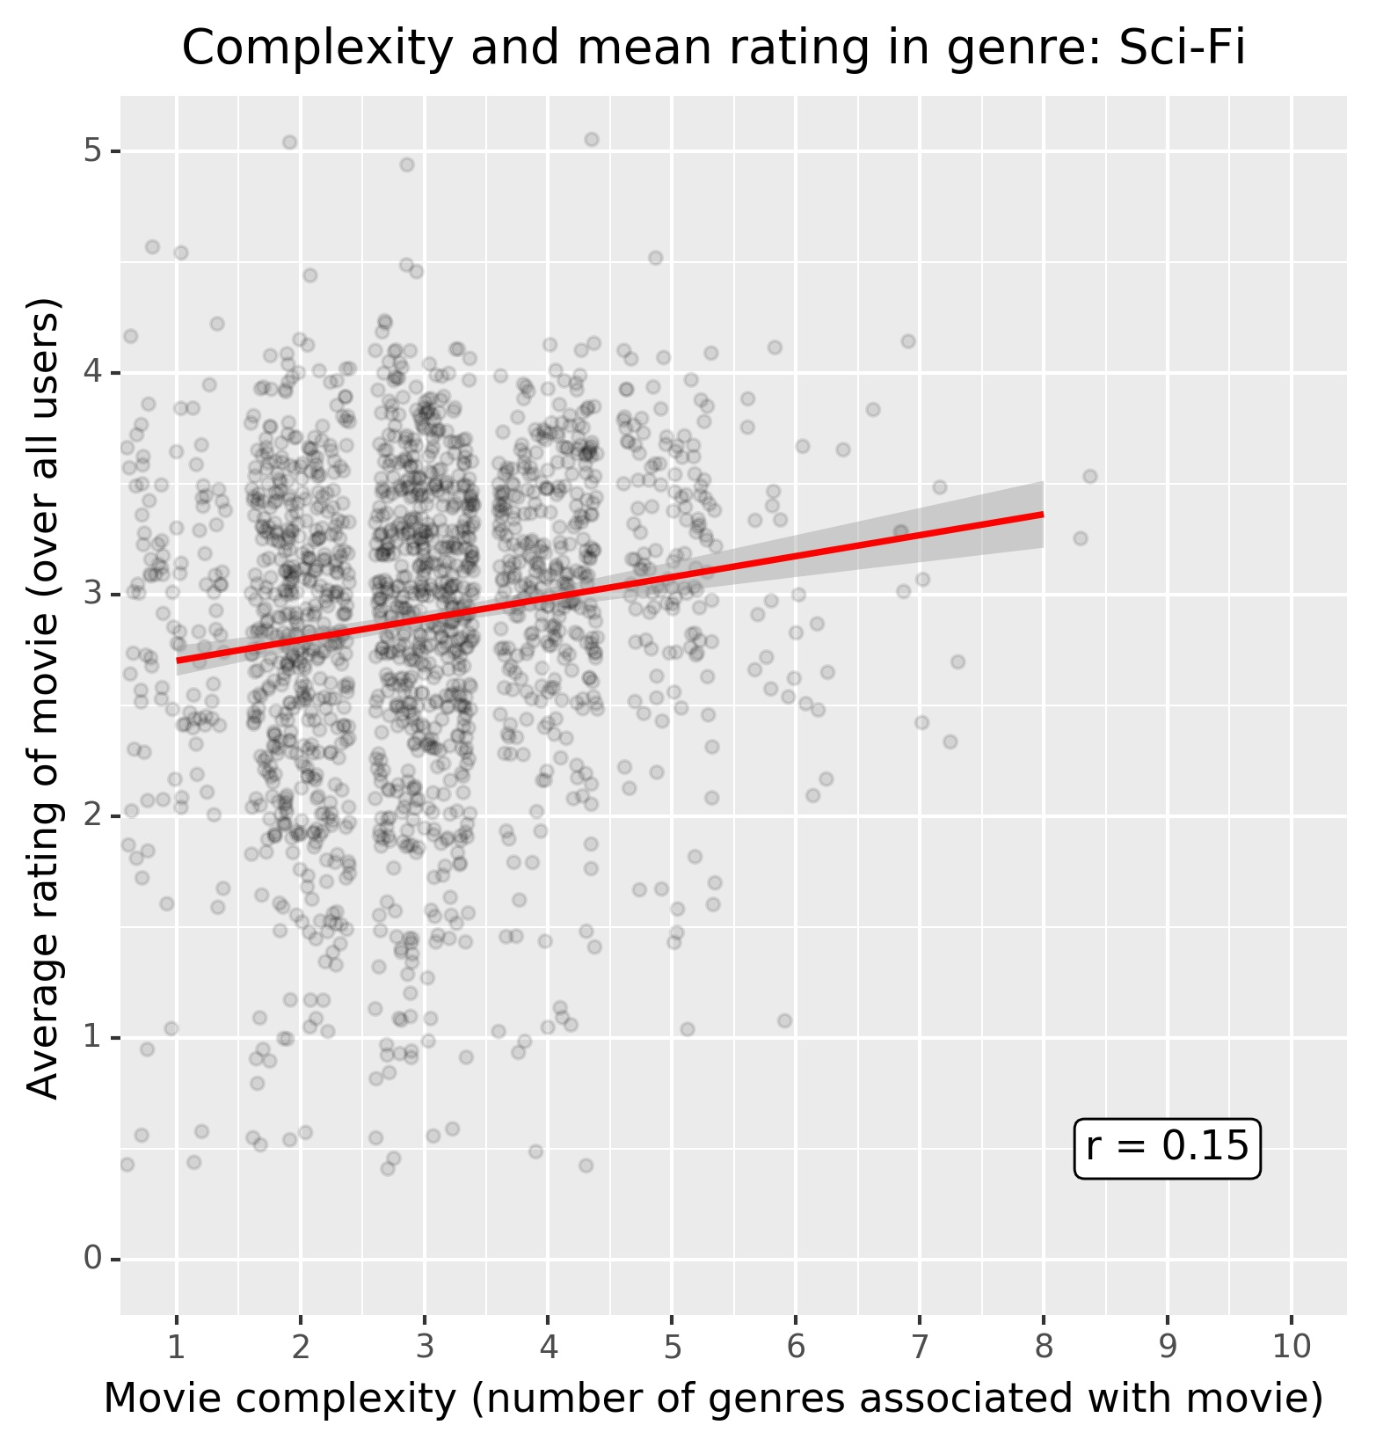
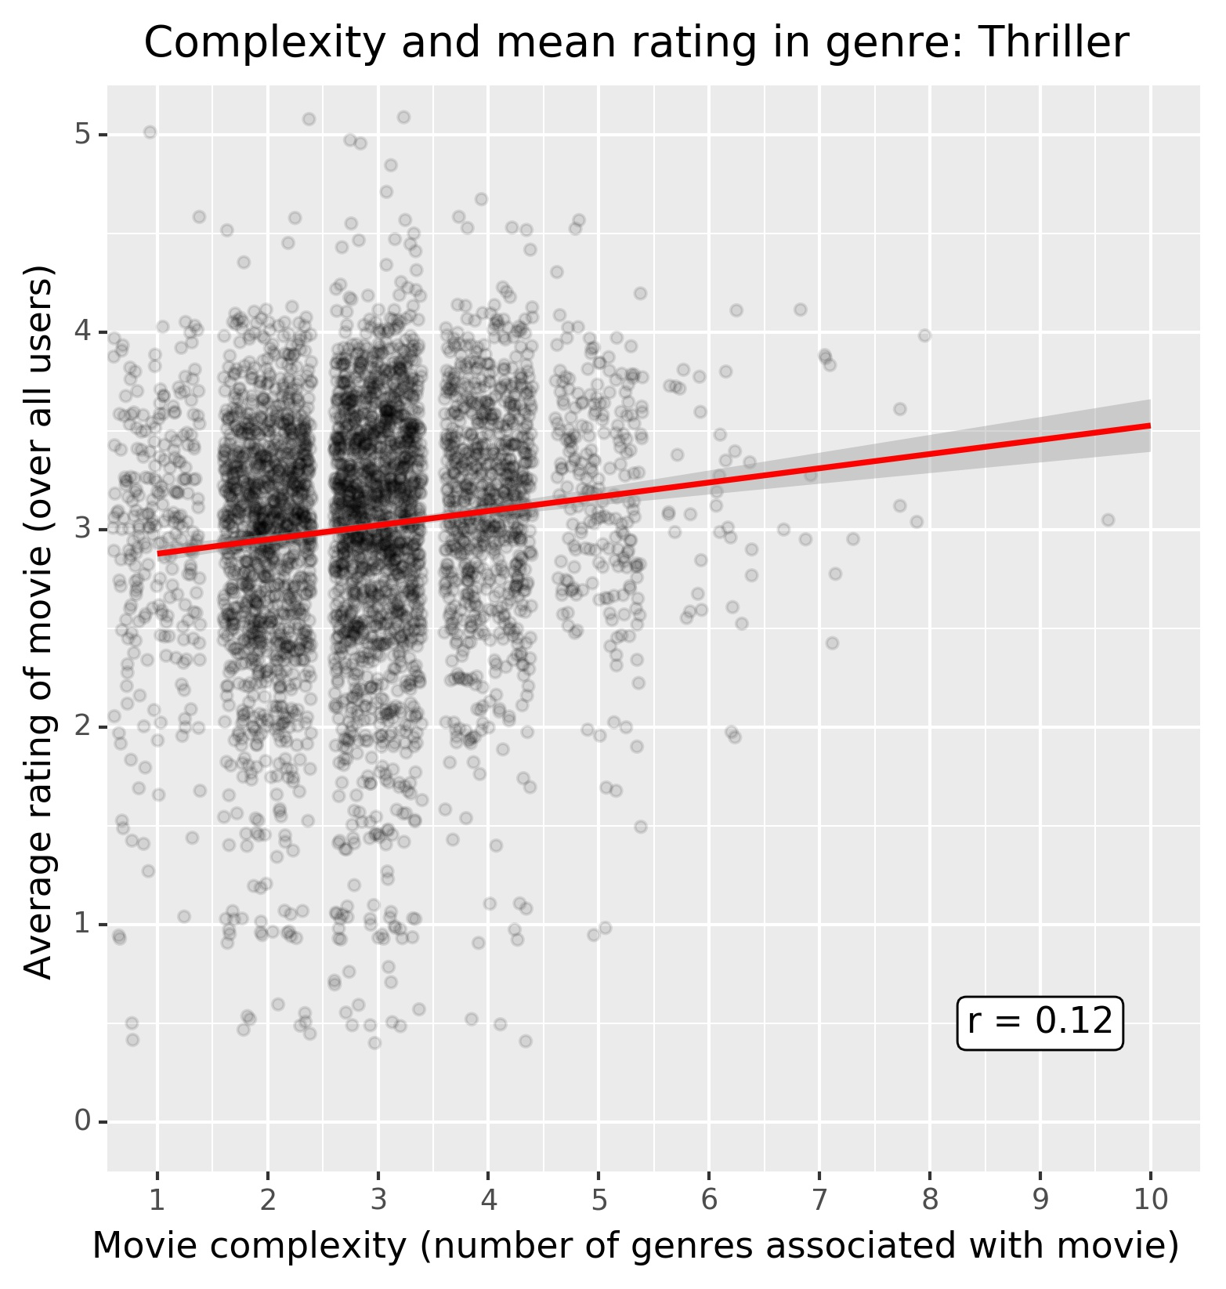
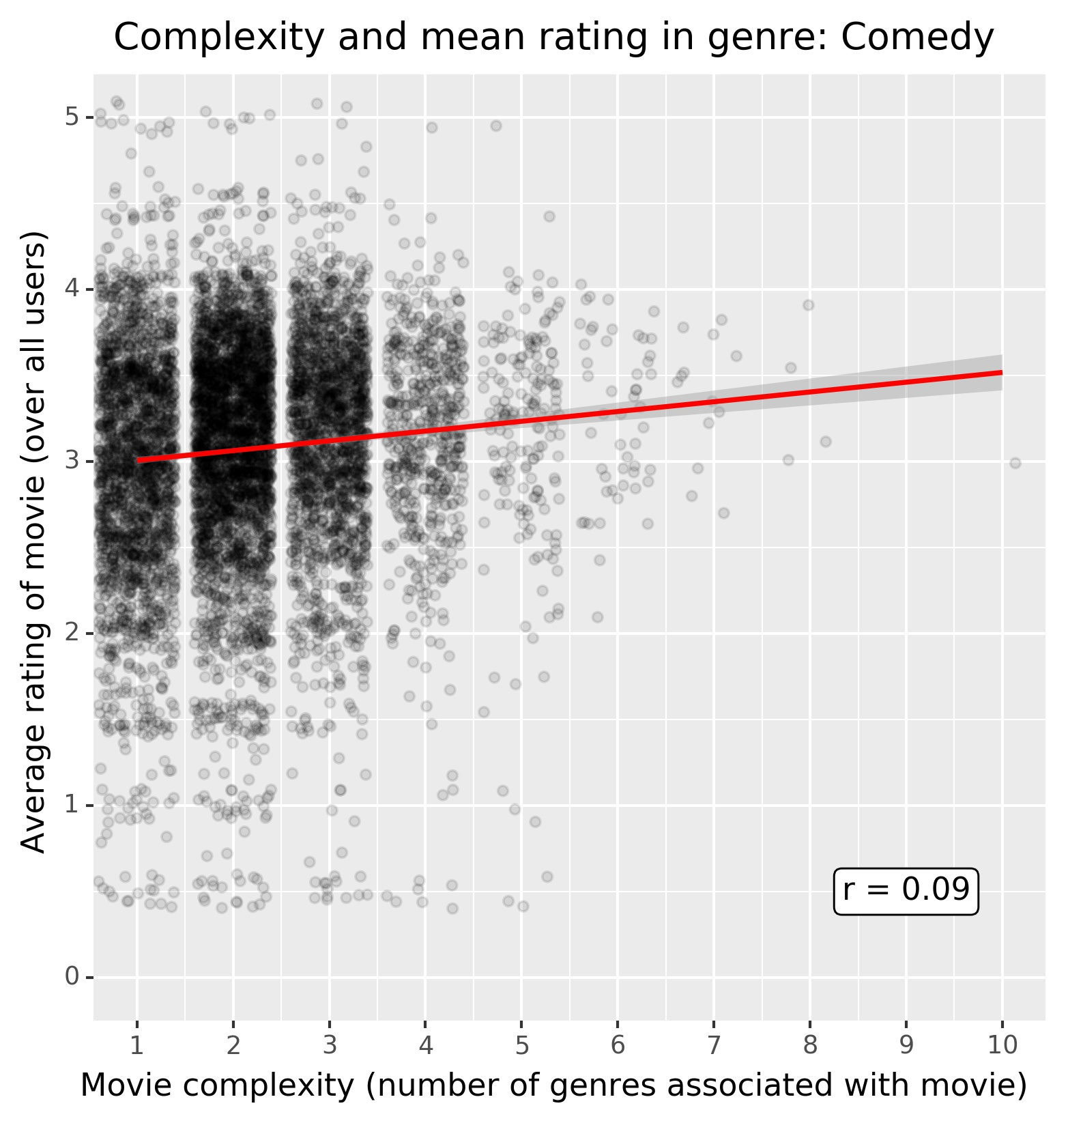
Findings
Genre | n | r
Horror | 2279 | 0.198
Children | 986 | 0.182
Action | 3073 | 0.157
Sci-Fi | 1561 | 0.148
Thriller | 3681 | 0.132
Comedy | 7173 | 0.117
Mystery | 1295 | 0.099
Animation | 895 | 0.097
IMAX | 193 | 0.091
Musical | 918 | 0.090
Adventure | 2019 | 0.069
Western | 547 | 0.047
Romance | 3561 | 0.044
Fantasy | 1255 | 0.041
Crime | 2531 | 0.034
Film-Noir | 297 | -0.000
Documentary | 1827 | -0.038
Drama | 11397 | -0.042
War | 1040 | -0.073
Some genres show slight correlations of complexity and movie rating (higher complexity associated with higher ratings)
6 Genres have correlations greater than 0.10 (figure on the right)
Highest correlation for the horror genre (r = 0.198)
Table: Pearson correlations (r) and sample sizes (n) within each genre subgroup. Each subgroup contains data of any movie that was associated with the respective genre (i.e., multiple plots might contain the same movie, if associated with multiple genres)
Figure: Movie ratings and complexity per genre. Each subplot contains data of any movie that was associated with the respective genre. As in main plot, data is jittered and the red line depicts a linear regression model fitted to the data in the plot.

Slide 7
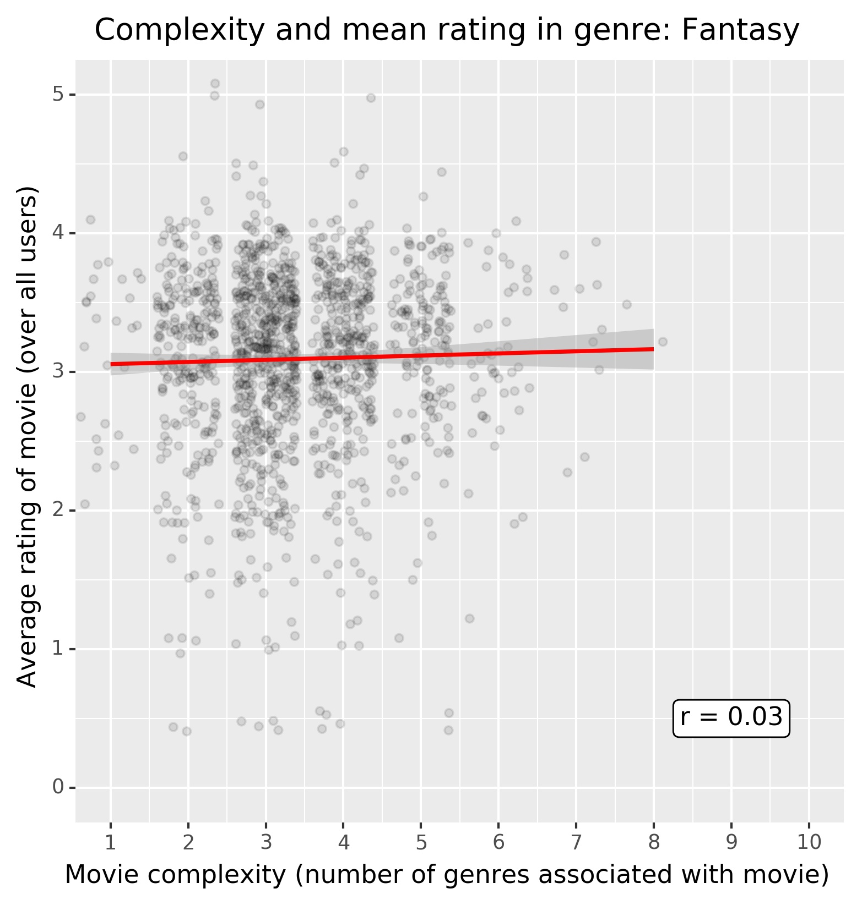
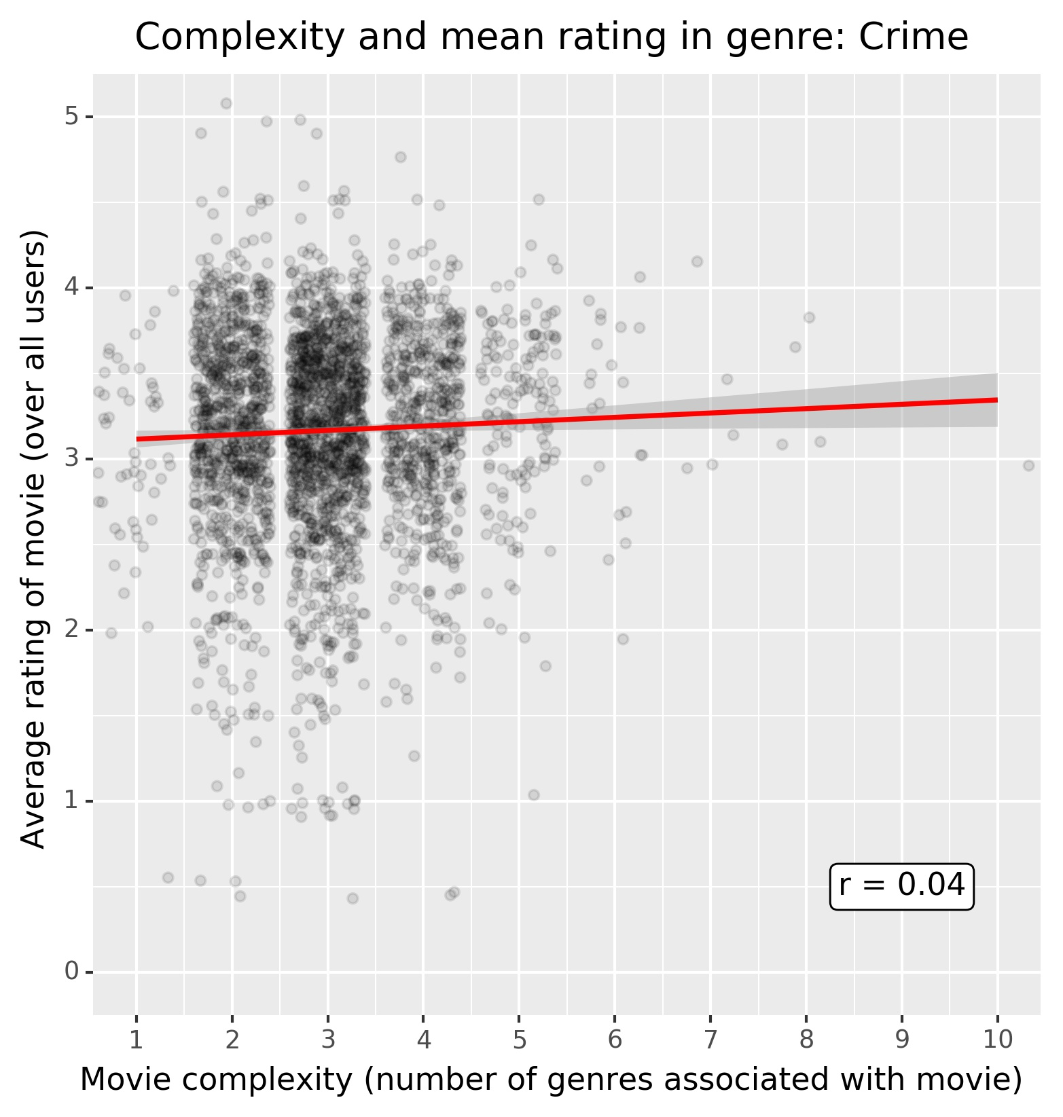
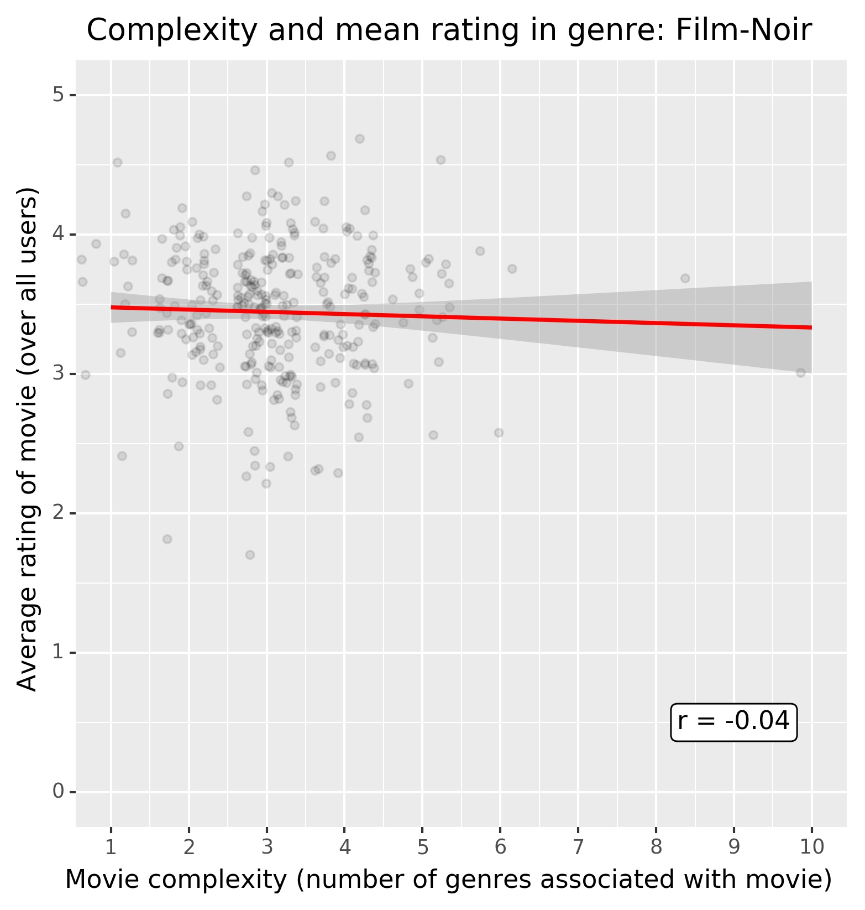
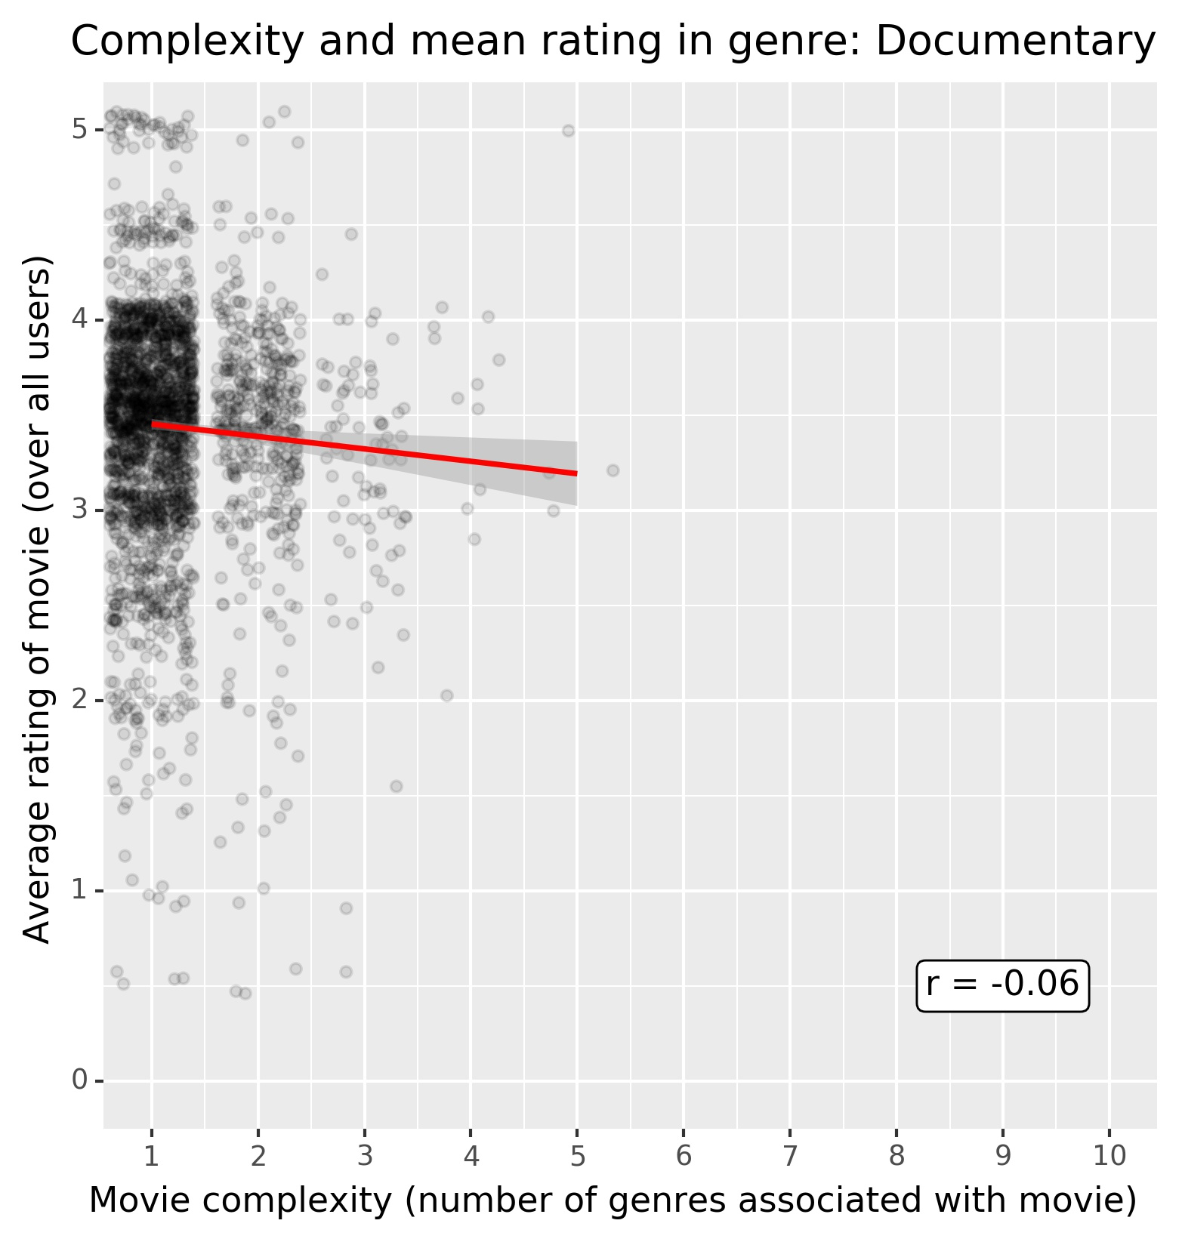
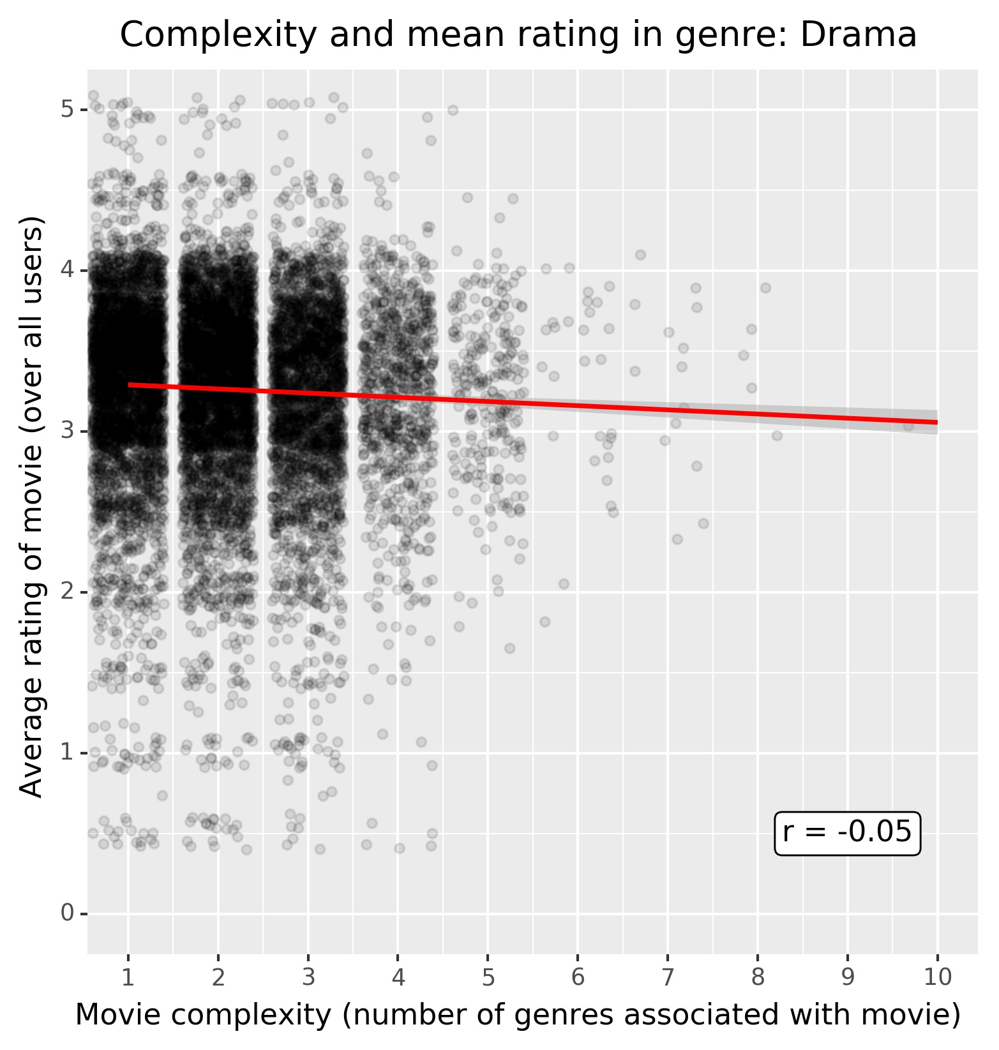
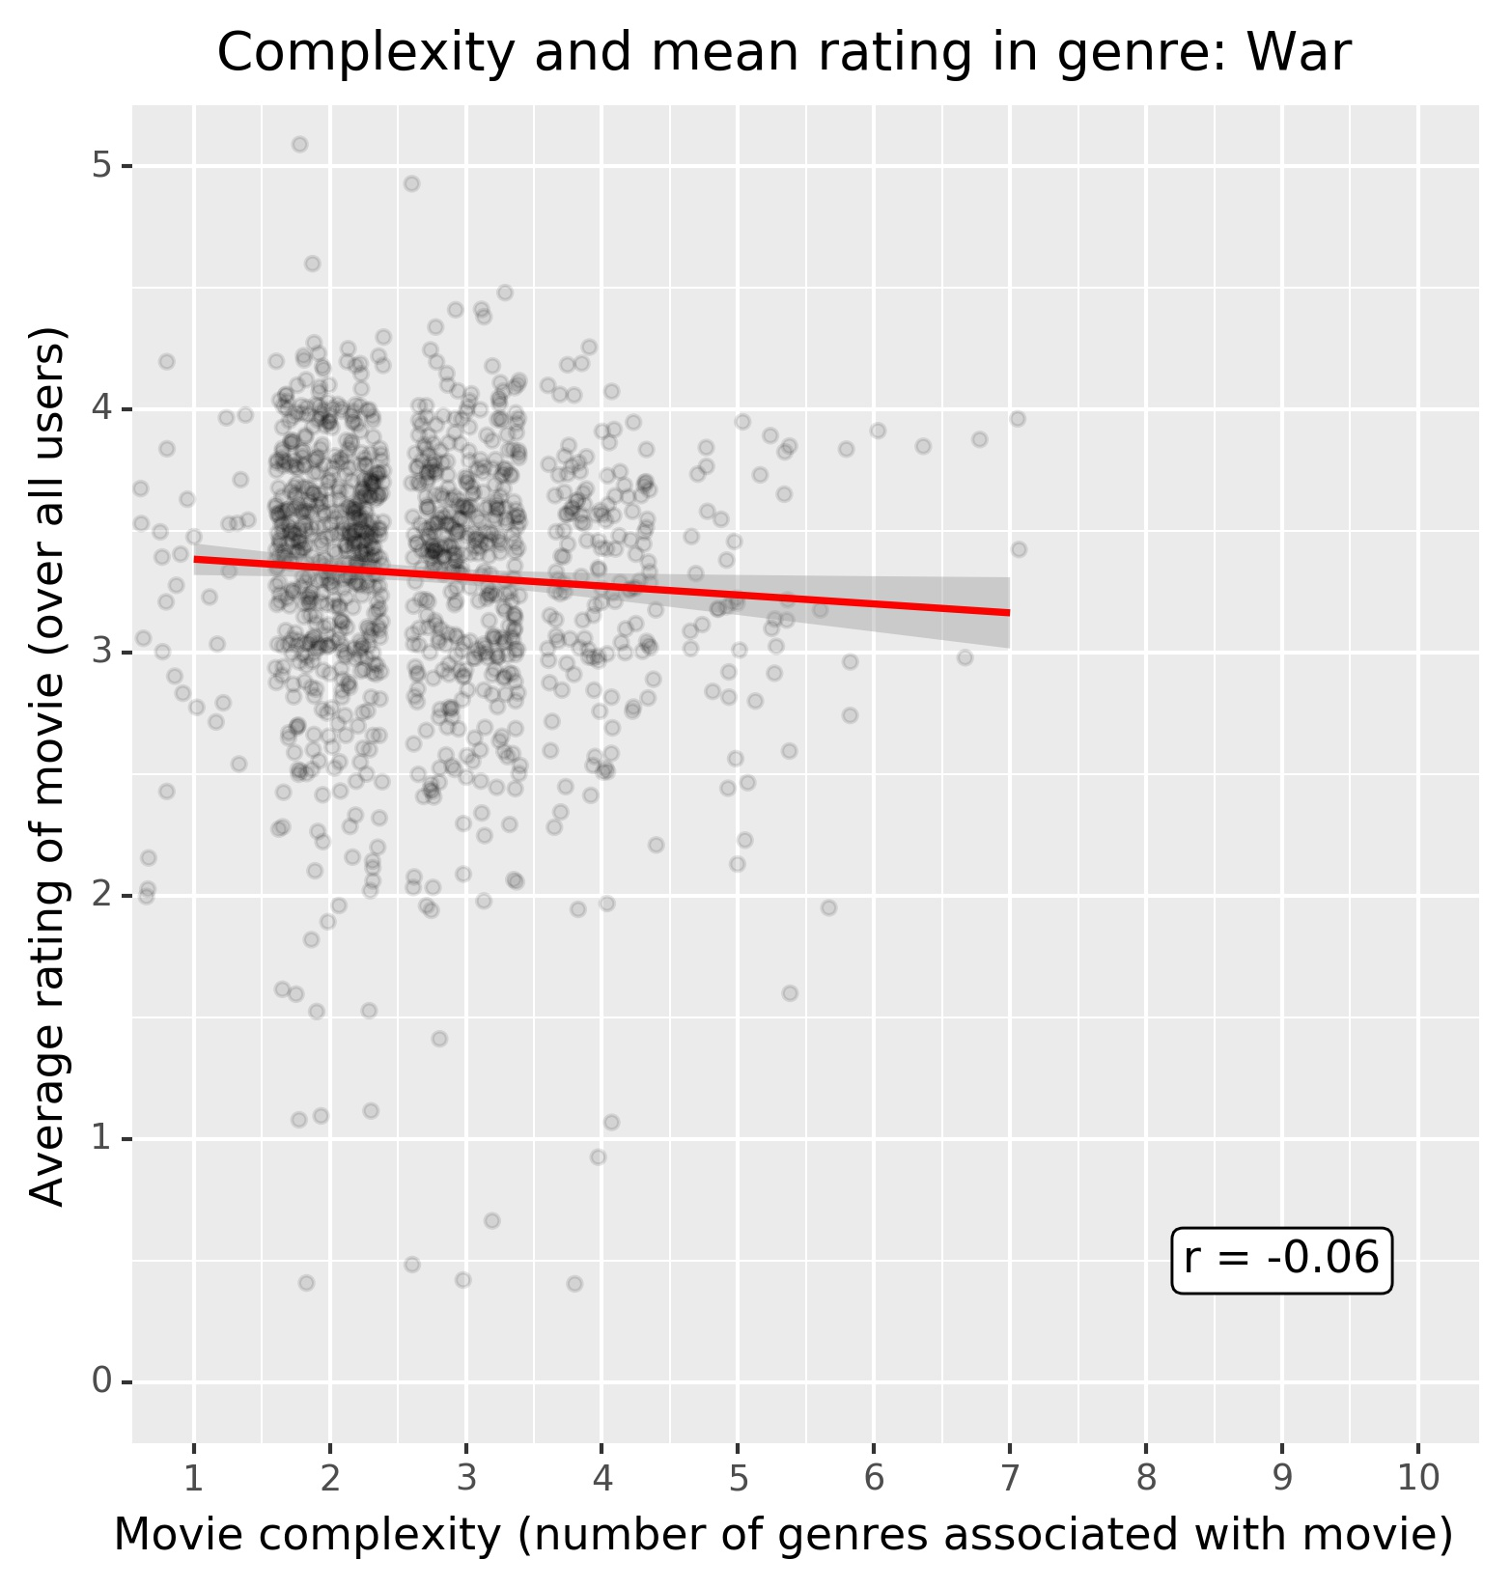
Findings
Most genres do not display any relevant correlation

Slide 8
Findings

Slide 9
Acknowledgements
Did you use other informal analysis to inform your work? Did you get feedback on your work by friends or colleagues? Etc.
If you had no one give you feedback, it’s okay to say that.

Slide 10
References
If applicable, report any references you used in your work. For example, you may have used a research paper from X to help guide your analysis. You should cite that work here. If you did all the work on your own, please state this.

